Slide 1
Object-oriented Programming
Week 11 | Lecture 1

Slide 2
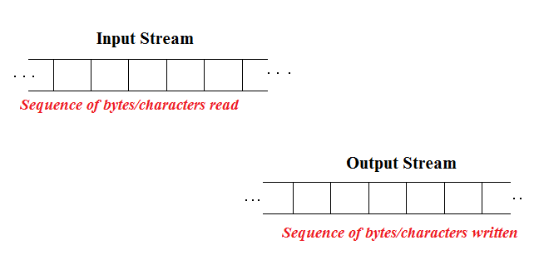
Stream

Slide 3
Notes
The default end-of-file (EOF) character sequence in Windows is Ctrl+Z
The default delimiter in most systems is ‘\n’ or newline character

Slide 4
istream/ostream Member Functions
Both the istream and ostream classes provide (arguably) useful member functions for input/output of data
These member functions can be called using the iostream objects such as cin & cout

Slide 5
ostream Member Functions
put()
We can use the put member function to output characters
cout.put(‘A’); // prints A
cout .put(‘B’).put(‘\n’); //prints B & then a newline
cout.put(65) // prints A

Slide 6
istream Member Function
get()
The get() function with no arguments inputs one character from the input stream (including white-space and other characters like end-of-file key sequence Ctrl+Z) and returns it as the value of the function call

Slide 7
istream Member Function
get(char_argument)
The get member function with a character-reference argument inputs the next character from the input stream (even if this is a white-space character) and stores it in the character argument.

Slide 8
istream Member Function
get(char_arr, size, delimiter_character)
It takes a character array, a size limit and a delimiter (with default value '\n'). This version reads characters from the input stream. It either reads characters specified by size or terminates as soon as delimiter is read. The input string is stored in the character array

Slide 9
istream Member Function
eof()
It returns 1 (TRUE) when there are no more data to be read from an input stream, and 0 (FALSE) otherwise

Slide 10
int main() { int character; cout << “Before input, cin.eof() is ”<< cin.eof(); cout << “Enter input followed by eof” << endl; while((character = cin.get()) != EOF) cout.put( character ); cout << “EOF in this system is: ” << character; cout << “After input, cin.eof() is: ” << cin.eof(); }

Slide 11
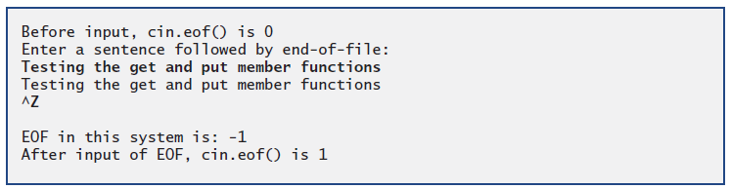
Output

Slide 12
istream Member Function
ignore()
The ignore() function of istream reads and discards a designated number of characters (the default is one) or terminates upon encountering a designated delimiter

Slide 13
istream Member Function
putback()
The putback() function places the previous character obtained by a get from an input stream back into that stream

Slide 14
istream Member Function
peek()
The peek() function returns the next character from an input stream but does not remove the character from the stream

Slide 15
Next Lecture
File I/O!

